Slide 1
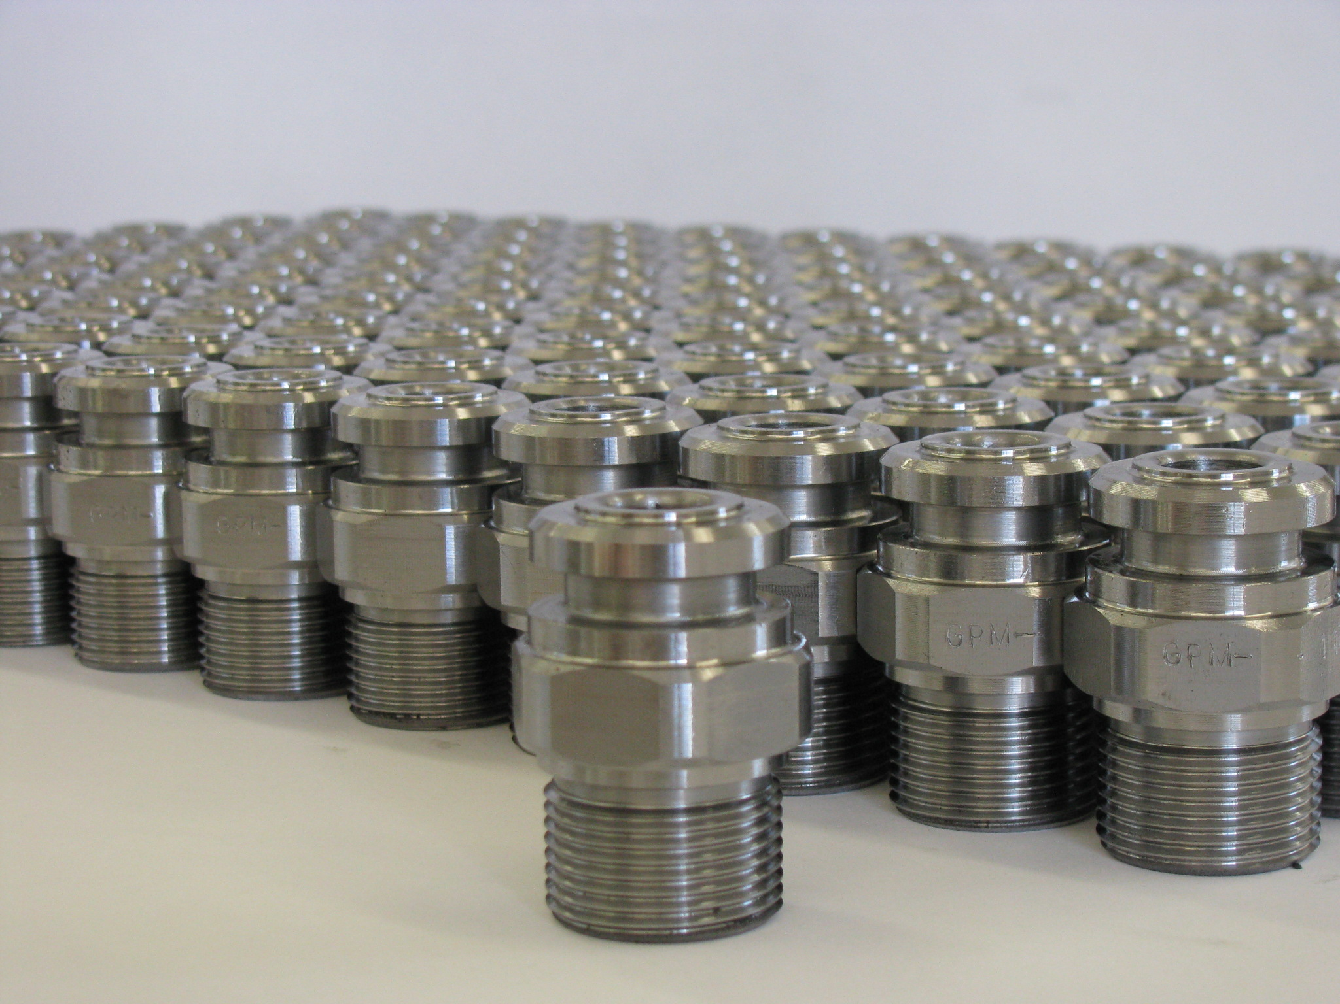
Assembly Document - Essentials
Presenter
Developer Technical Services

Slide 2
Agenda
Assembly End User vs API
Assembly Structure
Transient Geometry: using Matrices and Vectors
Proxies
Constraints
Lab: Constraints creation

Slide 3
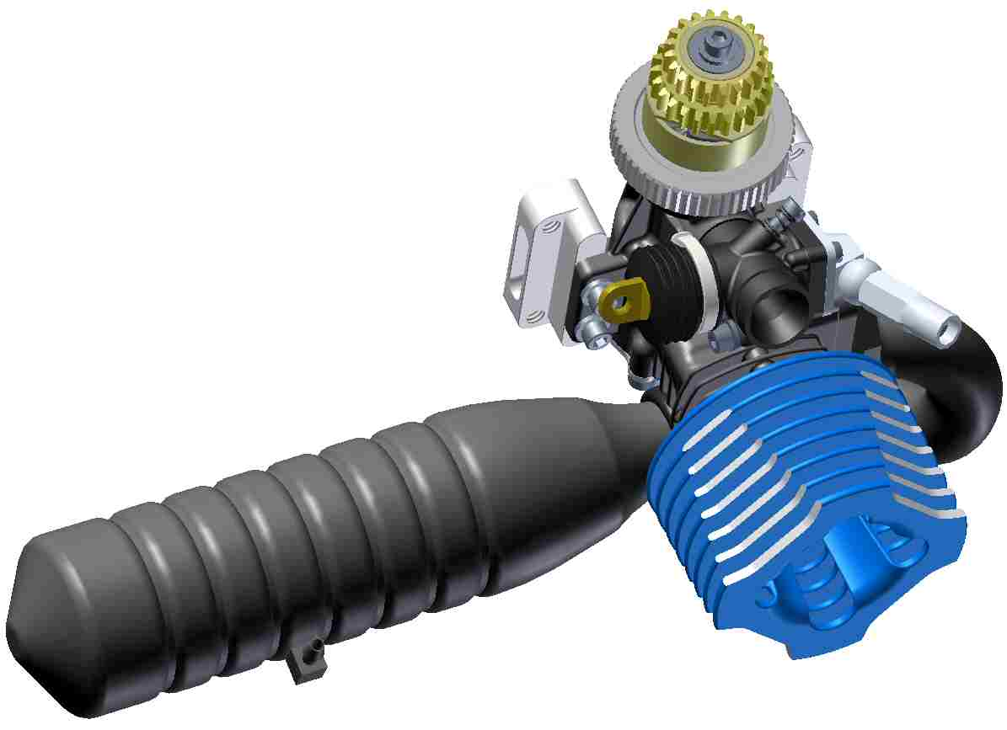
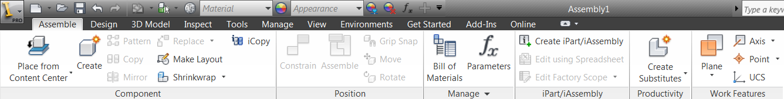
Assembly Documents
The API supports most of the assembly functionality.
Placing & creating components.
Editing components
Patterns
Constraints
Work features
Parameters
iMates
Sketches
Features
Representations
iAssemblies
BOM

Slide 4
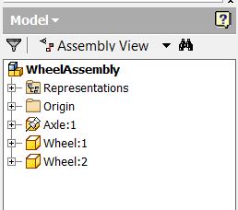
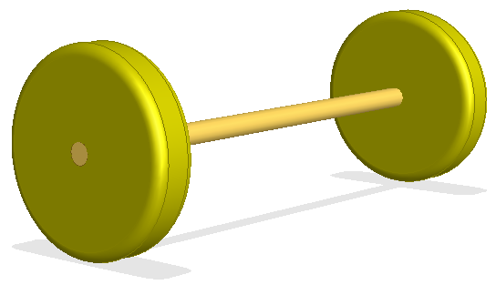
Assembly Document as an End User

Slide 5
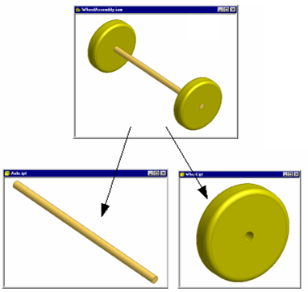
Assembly Document Through the API
Assembly documents contain:
references to other documents
occurrence information, constraints
work features
No geometry is in the assembly document, only references to parts and other assemblies. (Assembly features are a special case exception.)
WheelAssembly.iam
References:
Axle.ipt
Wheel.ipt
Occurrences:
Axle:1, Reference1, (0,0,0,…), Visible, …
Wheel:1, Reference2, (0,0,-2,…), Visible, …
Wheel:2 Reference3, (0,0,-2,…), Visible, …

Slide 6
Assembly Document Structure API
The ComponentOccurrences object is accessed through the Occurrences property and allows iteration over all existing occurrences and provides support to add additional occurrences.
The DocumentDescriptorsEnumerator object is accessed through the ReferencedDocumentDescriptors property and provides access to the documents referenced by this document.
WheelAssembly.iam
References:
Axle.ipt
Wheel.ipt
Occurrences:
Axle:1, Reference1, (0,0,0,…), Visible, …
Wheel:1, Reference2, (0,0,-2,…), Visible, …
Wheel:2 Reference3, (0,0,-2,…), Visible, …
Notes:
For more details about ReferencedDocumentDescriptors see File References in Module 14 – Assembly Document Advaced

Slide 7
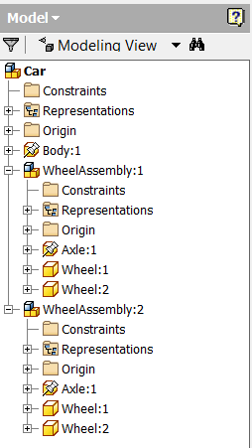
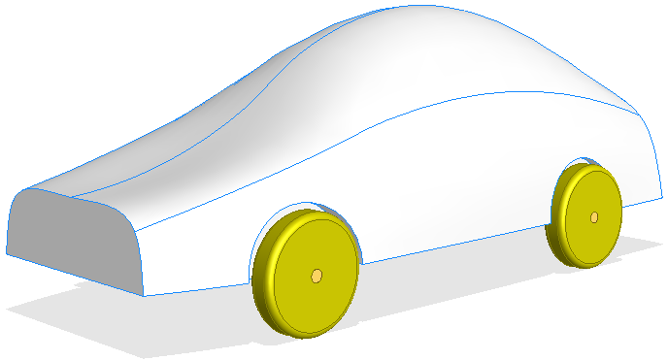
Assembly Structure Traversal

Slide 8
Assembly Structure Traversal - Example
Public Sub AssemblyTraversal()
' Get the active document, assuming it's an assembly.
Dim oAsmDoc As AssemblyDocument
oAsmDoc = _InvApplication.ActiveDocument
Call TraverseAsm(oAsmDoc.ComponentDefinition.Occurrences, 1)
End Sub
Private Sub TraverseAsm(ByVal oOccurrences As ComponentOccurrences, ByVal Level As Integer)
' Iterate through the current list of occurrences.
Dim oOcc As ComponentOccurrence
For Each oOcc In oOccurrences
' Print the name of the current occurence.
Debug.Print(Space(Level * 3) & oOcc.Name)
' If the current occurrence is a subassembly then call this sub
' again passing in the collection for the current occurrence.
If oOcc.DefinitionDocumentType = DocumentTypeEnum.kAssemblyDocumentObject Then
Call TraverseAsm(oOcc.SubOccurrences, Level + 1)
End If
Next
End Sub
Notes:
'/////////////////////////////////////////////////////////////////////////////////////////////////////////////
'// Sample
'//
'// Use: Assembly Traversal
'/////////////////////////////////////////////////////////////////////////////////////////////////////////////
Public Sub AssemblyTraversal()
Dim oDoc As AssemblyDocument
oDoc = _InvApplication.ActiveDocument
'Call the recursive function to iterate through the assembly tree
Call AssemblyTraversalRec(oDoc.ComponentDefinition.Occurrences, 0)
End Sub
Private Sub AssemblyTraversalRec(ByVal InCollection As ComponentOccurrences, ByVal level As Long)
'Iterate through the components in the current collection
Dim oCompOccurrence As ComponentOccurrence
For Each oCompOccurrence In InCollection
If oCompOccurrence.DefinitionDocumentType = DocumentTypeEnum.kAssemblyDocumentObject Then
Debug.Print(Space(3 * level) & " - [Asm] " & oCompOccurrence.Name)
Else
Debug.Print(Space(3 * level) & " - [Part] " & oCompOccurrence.Name)
End If
'Recursively call this function for the sub-occurrences of the current component
Call AssemblyTraversalRec(oCompOccurrence.SubOccurrences, level + 1)
Next
End Sub

Slide 9
Creating Occurrences
Add( FileName As String, Position As Matrix ) As ComponentOccurrence
AddByComponentDefinition( CompDef As ComponentDefinition, Position As Matrix ) As ComponentOccurrence
AddUsingiMates( FileName As String, Position As Matrix ) As ComponentOccurrence
AddCustomiPartMember( FactoryFileName As String, Position As Matrix, FullFileName As String, [Row], [CustomInput] ) As ComponentOccurrence
AddiPartMember( FactoryFileName As String, Position As Matrix, [Row] ) As ComponentOccurrence
AddiAssemblyMember( FactoryDocumentName As String, Position As Matrix, [Row], [Options] ) As ComponentOccurrence

Slide 10
Creating an Occurrence - Example
Public Sub AddFromFile()
Dim oDoc As AssemblyDocument
oDoc = _InvApplication.ActiveDocument
Dim oMatrix As Matrix
oMatrix = _InvApplication.TransientGeometry.CreateMatrix
Dim oOcc As ComponentOccurrence
oOcc = oDoc.ComponentDefinition.Occurrences.Add("C:\Temp\Part1.ipt", oMatrix)
End Sub
Public Sub AddFromMemory()
Dim oDoc As AssemblyDocument
oDoc = _InvApplication.ActiveDocument
Dim oPartDoc As PartDocument
oPartDoc = _InvApplication.Documents.Add(kPartDocumentObject, False)
Dim oMatrix As Matrix
oMatrix = _InvApplication.TransientGeometry.CreateMatrix
Dim oOcc As ComponentOccurrence
oOcc = oDoc.ComponentDefinition.Occurrences.AddByComponentDefinition( _
oPartDoc.ComponentDefinition, oMatrix)
End Sub

Slide 11
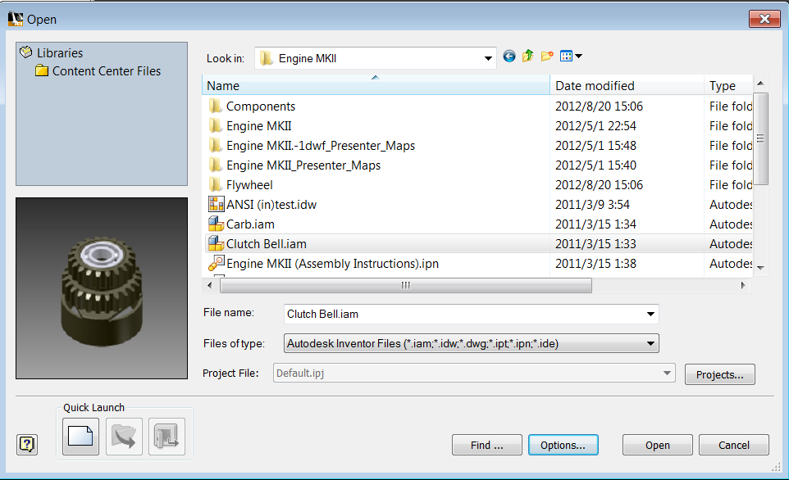
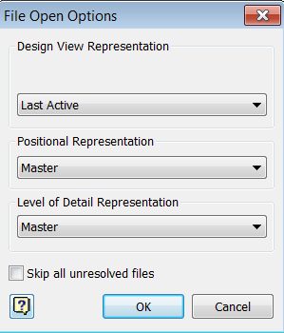
Creating Occurrences With Options
AddWithOptions(FullDocumentName As String, Position As Matrix, _ Options As NameValueMap) As ComponentOccurrence
Options
PrivateRepresentationFileName
DesignViewRepresentation
PositionalRepresentation
LevelOfDetailRepresentation
UseiMate
DesignViewAssociative

Slide 12
Add With Options - Example
'Create a new NameValueMap object
Dim oOptions As NameValueMap
oOptions = _InvApplication.TransientObjects.CreateNameValueMap
' Set the representations to use when creating the occurrence.
Call oOptions.Add("LevelOfDetailRepresentation", "MyLODRep")
Call oOptions.Add("PositionalRepresentation", "MyPositionalRep")
Call oOptions.Add("DesignViewRepresentation", "MyDesignViewRep")
Call oOptions.Add("DesignViewAssociative", True)
' Add the occurrence.
Dim oOcc As ComponentOccurrence
oOcc = oAsmCompDef.Occurrences.AddWithOptions("C:\Temp\Reps.iam", _
oMatrix, oOptions)

Slide 13
Transient Geometry Math Objects
The TransientGeometry object allows you to create some mathematical objects that can be used as input for methods and properties and also used internally for your own calculations.
Point, Point2d
Matrix, Matrix2d
Vector, Vector2d
UnitVector, UnitVector2d
Box, Box2d

Slide 14
What is a Matrix?
A matrix is a rectangular array of numbers.
A 3-D matrix is a 4x4 matrix.
A 2-D matrix is a 3x3 matrix.
1 0 0 0
0 1 0 0
0 0 1 0
0 0 0 1
1 0 0
0 1 0
0 0 1

Slide 15
A Matrix in Inventor
In computer graphics a matrix is commonly used to:
Define a coordinate system.
Define a transformation.
Inventor uses this concept for occurrences in assemblies, sketches in parts, and drawing view contents transformations.

Slide 16
Matrix and Occurrences
When placing an occurrence the matrix defines the position of the part within the assembly. It defines the position of the part coordinate system within the assembly space.
Getting the Transformation property of an occurrence returns the matrix that defines the occurrence’s current position in the assembly.
Setting the Transformation property repositions the occurrence (taking into account any constraints).
SetTransformWithoutConstraints transforms the occurrence ignoring any constraints (until the next recompute of the assembly).

Slide 17
Matrix as a Transform
A matrix can be used to define a transformation for an existing object.
Repositioning an occurrence within an assembly.
Defining the change from one coordinate system to another. For example, in an assembly transforming a point from one part into another part.
For a transformation the matrix defines the delta change to apply. The change can be a move and/or a rotate.
Notes:
'/////////////////////////////////////////////////////////////////////////////////////////////////////////////
'// Sample
'//
'// Use: Move occurrence
'/////////////////////////////////////////////////////////////////////////////////////////////////////////////
Public Sub MoveOccurrence()
Dim oAsm As AssemblyDocument
oAsm = _InvApplication.ActiveDocument
Dim oTG As TransientGeometry
oTG = _InvApplication.TransientGeometry
Dim oOcc1 As ComponentOccurrence
oOcc1 = oAsm.ComponentDefinition.Occurrences(1)
Dim oNewMatrix As Matrix
oNewMatrix = oOcc1.Transformation
Call oNewMatrix.SetTranslation(oTG.CreateVector(5, 5, 5), False)
oOcc1.Transformation = oNewMatrix
End Sub
'/////////////////////////////////////////////////////////////////////////////////////////////////////////////
'// Sample
'//
'// Use: Rotate occurrence
'/////////////////////////////////////////////////////////////////////////////////////////////////////////////
Private Class Timer
Dim _previous As DateTime
Public Sub New()
_previous = DateTime.Now
End Sub
Public Function GetElapsedSeconds() As Double
Dim Now As DateTime = DateTime.Now
Dim Elaspsed As TimeSpan = Now.Subtract(_previous)
_previous = Now
GetElapsedSeconds = Elaspsed.TotalSeconds
End Function
End Class
Private Sub RotateOccurrence(ByVal oOccurrence As ComponentOccurrence, ByVal oAngleDeg As Double)
Dim oTG As TransientGeometry
oTG = _InvApplication.TransientGeometry
Dim oRotMatrix As Matrix
oRotMatrix = oTG.CreateMatrix
Call oRotMatrix.SetToRotation(oAngleDeg * (System.Math.PI / 180), oTG.CreateVector(0, 0, 1), oTG.CreatePoint(0, 0, 0))
Dim oNewMatrix As Matrix
oNewMatrix = oOccurrence.Transformation
Call oNewMatrix.PreMultiplyBy(oRotMatrix)
oOccurrence.Transformation = oNewMatrix
End Sub
Public Sub RotateOccurrenceTest()
Dim oAsm As AssemblyDocument
oAsm = _InvApplication.ActiveDocument
Dim oOcc1 As ComponentOccurrence
oOcc1 = oAsm.ComponentDefinition.Occurrences(1)
Dim Timer As New Timer
Dim dT As Double = 0
While dT < 10
Call RotateOccurrence(oOcc1, 5)
System.Windows.Forms.Application.DoEvents()
dT = dT + Timer.GetElapsedSeconds
End While
End Sub

Slide 18
Matrix Functions
Matrix.Invert reverses the transform the matrix defines.
Matrix.TransformBy changes the matrix to include the transformation defined by a second matrix.
Matrix.Cell allows you to get/set individual cells of the matrix.
SetCoordinateSystem, SetToAlignCoordinateSystems, SetToIdentity, SetToRotateTo, SetToRotation, and SetTranslation are for convenience in defining the matrix.

Slide 19
Vectors
Vectors define a direction and magnitude.
A Vector can be used to define the movement of the part shown below.
A UnitVector defines a direction. Its magnitude is always 1.

Slide 20
Lab: Positionning Occurrences
Write a .Net program with 2 methods:
1. A method that creates an assembly document, inserts an occurrence in the new assembly with no specific transformation
2. A method that takes as input:
- an occurrence
- a translation vector Tx
- an axis vector Ax
- an angle Alpha (in degrees)
And that translates the occurrence of Tx, rotates it of Alpha around axis Ax with the center of rotation at the occurrence gravity center.

Slide 21
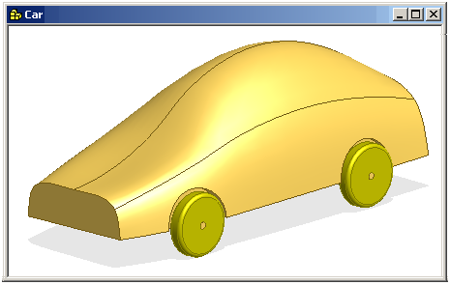
Assembly Document - Proxies
Q: How do you access geometry within the context of an assembly since geometry doesn’t exist in assemblies?
A: A proxy represents an entity as if the entity actually exists in the assembly.

Slide 22
Proxy Objects
Proxy objects are derived from the regular object they represent.
They support every method and property the original object supports.
These methods and properties will return information in the context of the assembly.
In addition to the functions of the base class object, proxies also support:
ContainingOccurrence – Returns the occurrence the proxy is representing the real object within.
NativeObject – Returns the actual object the proxy is representing.

Slide 23
Proxy Objects
Proxies define a path to the actual object.
Cylindrical Face 1
Wheel:1\CylinderFace
Cylindrical Face 2
Wheel:2\CylinderFace
Proxies are returned when the user selects entities.
Proxies can be created using the CreateGeometryProxy method.
Existing proxy paths can be trimmed using AdjustProxyContext method.
Paths can be examined using OccurrencePath property.

Slide 24
Creating Proxies - Example
Public Sub CreateProxy()
Dim oAsmDef As AssemblyComponentDefinition
oAsmDef = _InvApplication.ActiveDocument.ComponentDefinition
Dim oOcc1 As ComponentOccurrence = oAsmDef.Occurrences(1)
Dim oOcc2 As ComponentOccurrence = oAsmDef.Occurrences(2)
' Get the vertex through the occurrence
' which will return a VertexProxy object.
Dim oVertexPx1 As VertexProxy
oVertexPx1 = oOcc1.SurfaceBodies(1).Vertices(1)
' Get the vertex from the part and create a VertexProxy object.
Dim oVertex2 As Vertex
oVertex2 = oOcc2.Definition.SurfaceBodies(1).Vertices(1)
Dim oVertexPx2 As VertexProxy = Nothing
Call oOcc2.CreateGeometryProxy(oVertex2, oVertexPx2)
End Sub

Slide 25
Assembly Document – Constraints
Constraint creation can take as input work geometry from the assembly or proxies to entities in the attached parts.
Query of a constraint returns the associated entities and the parameter controlling the constraint.

Slide 26
Adding Constraints – from native objects
Public Sub MateConstraintOfWorkPlanes()
Dim oAsmCompDef As AssemblyComponentDefinition
oAsmCompDef = ThisApplication.ActiveDocument.ComponentDefinition
' Get references to the two occurrences to constrain.
' This arbitrarily gets the first and second occurrence.
Dim oOcc1 As ComponentOccurrence
oOcc1 = oAsmCompDef.Occurrences.Item(1)
Dim oOcc2 As ComponentOccurrence
oOcc2 = oAsmCompDef.Occurrences.Item(2)
' Get the XY plane from each occurrence. This goes to the
' component definition of the part to get this information.
' This is the same as accessing the part document directly.
' The work plane obtained is in the context of the part,
' not the assembly.
Dim oPartPlane1 As WorkPlane
oPartPlane1 = oOcc1.Definition.WorkPlanes.Item(3)
Dim oPartPlane2 As WorkPlane
oPartPlane2 = oOcc2.Definition.WorkPlanes.Item(3)
' Because we need the work plane in the context of the assembly
' we need to create proxies for the work planes. The proxies
' represent the work planes in the context of the assembly.
Dim oAsmPlane1 As WorkPlaneProxy
Call oOcc1.CreateGeometryProxy(oPartPlane1, oAsmPlane1)
Dim oAsmPlane2 As WorkPlaneProxy
Call oOcc2.CreateGeometryProxy(oPartPlane2, oAsmPlane2)
' Create the constraint using the work plane proxies.
Call oAsmCompDef.Constraints.AddMateConstraint(oAsmPlane1, oAsmPlane2, 0)
End Sub

Slide 27
Adding Constraints – from proxy objects
Public Sub MateConstraintWithLimits()
' Set a reference to the assembly component definintion.
Dim oAsmCompDef As AssemblyComponentDefinition
oAsmCompDef = ThisApplication.ActiveDocument.ComponentDefinition
' Set a reference to the select set.
Dim oSelectSet As SelectSet
oSelectSet = ThisApplication.ActiveDocument.SelectSet
' Validate the correct data is in the select set.
If oSelectSet.Count <> 2 Then
MsgBox ("You must select the two entities valid for mate.")
Exit Sub
End If
' Get the two entities from the select set.
Dim oBrepEnt1 As Object
Dim oBrepEnt2 As Object
oBrepEnt1 = oSelectSet.Item(1)
oBrepEnt2 = oSelectSet.Item(2)
' Create the mate constraint between the parts, with an offset value of 0.
Dim oMate As MateConstraint
oMate = oAsmCompDef.Constraints.AddMateConstraint(oBrepEnt1, oBrepEnt2, 0)
' Set a maximum value of 2 inches
oMate.ConstraintLimits.MaximumEnabled = True
oMate.ConstraintLimits.Maximum.Expression = "2 in"
' Set a minimum value of -2 inches
oMate.ConstraintLimits.MinimumEnabled = True
oMate.ConstraintLimits.Minimum.Expression = "-2 in"
End Sub

Slide 28
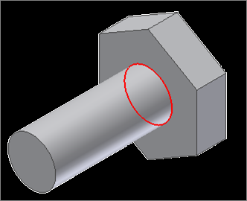
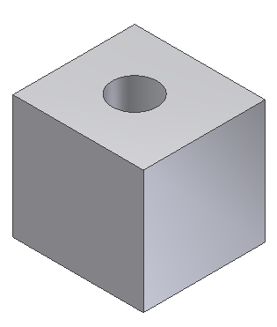
Lab: Creation of constraints
Manually (not with the API), create a simple bolt part like the one shown to the right.
Write a program to add an attribute to the cylinder face. This is used to “name” the edge to allow you to find in the next program.
Create another part that’s a block with one blind hole, similar to the one shown to the right. Add an attribute to the face of the hole as well.
Write a program that will (with an assembly active)
Insert the block part into the assembly.
Insert a bolt part into the assembly.
Use the Attribute API to find the faces of the hole and the bolt face.
Create an insert constraint between the bolt and the block using the attribute on the bolt and the faces just found.

Slide 29

Notes:
Thank you!
Questions?

